Slide 1
Corn, Wine and Oil
Masonic elements of consecration

Slide 2
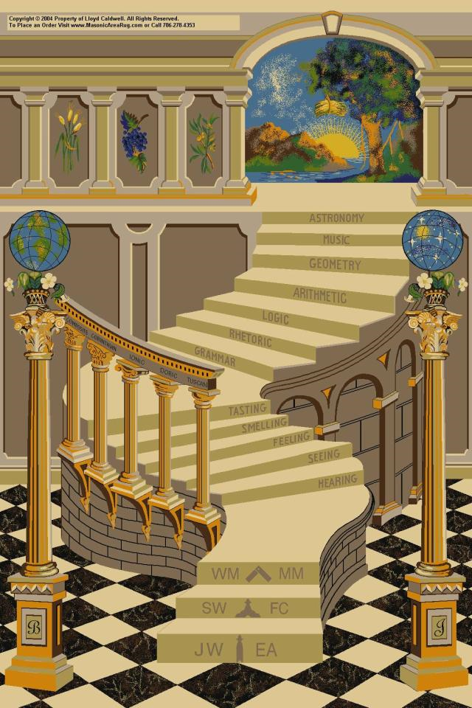
Way back in 1975
I received my FC degree.
I was struck by two elements:
The winding staircase lecture which “wowed me”.
The “G” lecture which did not.

Slide 3
Two things bothered me
As a MM, I received my monitor and could read the FC second section for the 1st time. I was confused.
The wages of a F.C. Mason
The ending phrase of the explanation of the symbolism of the degree which was not even read to me at the time of my degree.
What was the significance of the wages of a FCM and that final phrase?

Slide 4
Corn, Wine, and Oil
were the most important productions of early Eastern countries;
they constituted the wealth of the people, and were esteemed as the supports of life and the means of refreshment.
Corn refers to the grain of the realm, not maize.
Usually, this was wheat!

Slide 5
Corn, Wine, and Oil?
We all know that the Fellow Crafts were not actually paid in these commodities.
Imagine the logistics of paying 80,000 workers – the bags, sacks and flagons required!
They were paid no doubt with the coins of the realm.
But what was the importance of using these as symbolic wages?

Slide 6
King David
enumerated them among the greatest blessings that we enjoy, and speaks of them as
"wine that maketh glad the heart of man, and oil to make his face to shine, and bread which strengtheneth man's heart" (Psalm civ., 15).
Corn, Wine, and Oil are mentioned numerous times throughout the Bible, especially as elements of consecration.

Slide 7
Albert Mackey
"wherefore do you carry corn, wine, and oil in your processions, but to remind you that in the pilgrimage of human life you are to impart a portion of your bread to feed the hungry, to send a cup of your wine to cheer the sorrowful, and to pour the healing oil of your consolation into the wounds which sickness hath made in the bodies, or afflictions rent in the heart, of your fellow-travelers?"

Slide 8
In the Lodge,
we use them as symbols, save in the dedication, constitution and consecration of a new lodge and in the laying of cornerstones, when once again the fruit of the land, the brew of the grape and the essence of the olive are poured to launch a new unit of brotherhood into the fellowship of lodges; or to begin a new structure dedicated to the public use.

Slide 9
Why so little mention?
Corn, wine and oil are well known to Freemasons everywhere as symbolic wages. (what are we about to receive?)
From the 2nd section of the FC degree: AKA “G” lecture
“I congratulate you upon your arrival into the middle chamber. You have been admitted for the sake of . . . . The wages of a FCM are corn, wine, and oil . . . . “
Why mention them at all?

Slide 10
Consecration
Consecration is the solemn dedication to a special purpose or service.
The word "consecration" literally means "to associate with the sacred". Persons, places, or things can be consecrated, and the term is used in various ways by different groups.
The act of consecration is to remind us that what is to come is of great importance whether it be into an office or a new structure.

Slide 11
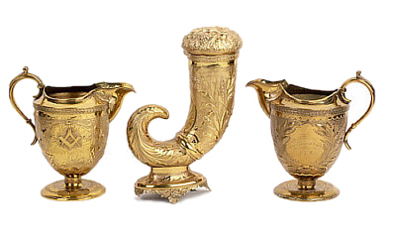
Consecration
The most referred elements mentioned in the Bible for Consecration are:
Corn, Wine, and Oil.
Especially Oil.

Slide 12
As the elements of
Consecration are mentioned in the FC degree, again what is the young FC about to receive that would be of such value as to insert them into the “G” lecture.
In my opinion, a clue is given us in the last phrase of the “G” lecture in the symbolism of the degree!

Slide 13
The smoking gun
. . .”which standing in the Middle Chamber, after his laborious ascent of the winding stairs, he can only approximate by the reception of an imperfect, yet glorious reward in the revelation of the “hieroglyphic light which none but craftsmen ever saw.”

Slide 14

What was that
“hieroglyphic light which none but craftsmen ever saw.”?
G

Slide 15
The letter "G"
represents not only "Yod" as the initial of the name of God, but also
as the character which illuminates the Middle Chamber of the Temple, as God illuminates the life of the Craftsman.
A Fellowcraft Lodge represents the Middle Chamber, and the letter "G" in the center represents "Yod" or God in the center of our lives.

Slide 16
My thesis
The Fellow Craft Mason is consecrated by the elements of Corn, Wine, and Oil to view for the first time, the name of the S.A.O.T.U.
Here is the first clue of what the L.W. of a M.M is, although the new FC has now idea of what is to come!
He has no idea that he has stared the central elements of his M.M. degree in the face!

Slide 17
FYI: the FC 2nd section
The winding staircase lecture was written by William Preston in the 1770’s.
The “G” lecture appears to have been written by Daniel Sickels, 33º around 1850.
“hieroglyphic light which none but craftsmen ever saw.” appears in quotes in the Arkansas monitor which indicates that it is being quoted from another source.

Slide 18
Bro. Robert Burns 1786
Oft have I met your social band,
And spent the cheerful, festive night:
Oft, honour'd with supreme command,
Presided o'er the Sons of Light,
And by that Hieroglyphic bright,
Which none but Craftsmen ever saw!
Strong Mem'ry on my Heart shall write
Those happy scenes, when far awa.

Slide 19
To sum up
Corn, Wine and Oil are symbolic wages which reminds us to feed the hungry, to send a cup of your wine to cheer the sorrowful, and to pour the healing oil of your consolation into the wounds which sickness hath made in the bodies, or afflictions rent in the heart, of your fellow-travelers."
By these elements of consecration, we are made ready to receive the True Word.

